Slide 1
ONLINE AUCTION SYSTEM

Slide 2
Hash it out!! members
Shivangi Agarwal
Shruti Jain
Shweta Tiwari
Pooja Joshi
Divyanshi Nigam
Akash Karsale
Srijnasri Negi
Akash Sirsikar
Shreya Rathi

Slide 3

Objective
The web-based system that allows bidding for items. The users who desire to participate in the bidding process must register themselves either as a seller or a buyer.

Slide 4
Application Features
Online Auction is a web based application project which will be used for the auctioning of products.
At present the user must register themselves as seller and buyer to schedule and place bids.

Slide 5






“ The seller can add products and schedule bids and buyer can place bids. Through this website: ->The seller can add products ->the seller can schedule the auction according to its needs.

Slide 6



“
->The seller can view and manage the products put up for auctioning.
->The buyer can place the bid on multiple products multiple times according to their preferences.
->The user needs to register themselves as the seller or buyer to access the online auction system.

Slide 7

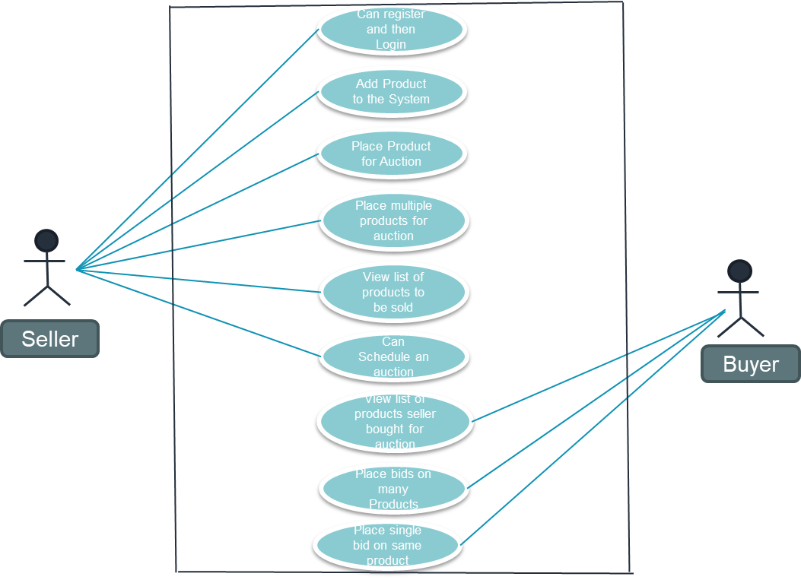

Slide 8
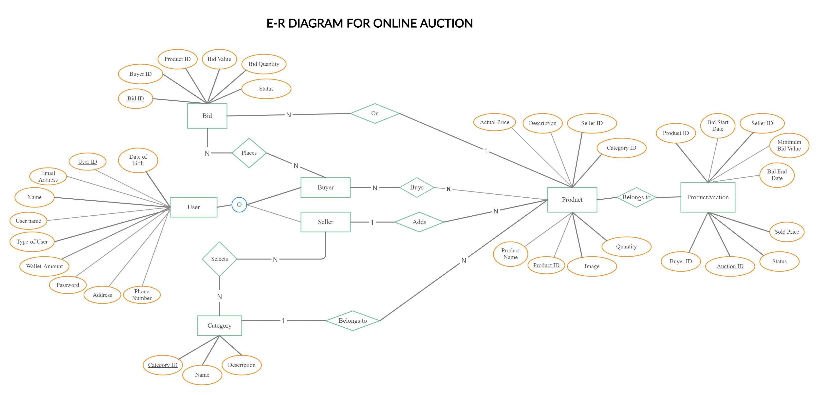
ER Diagram

Slide 9

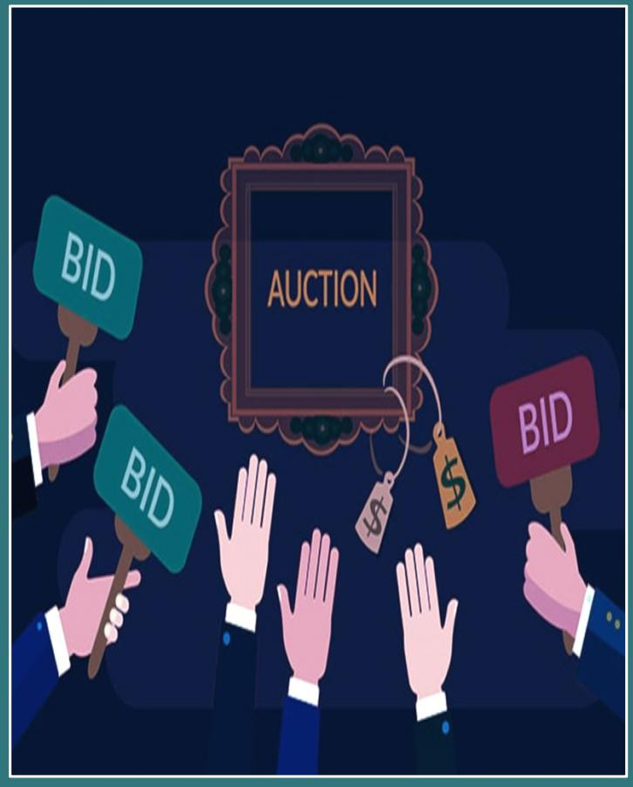
->Java
->CSS
->HTML
->Servlet
->JSP
->MVC Architecture
->JDBC
->Java Script

Slide 10
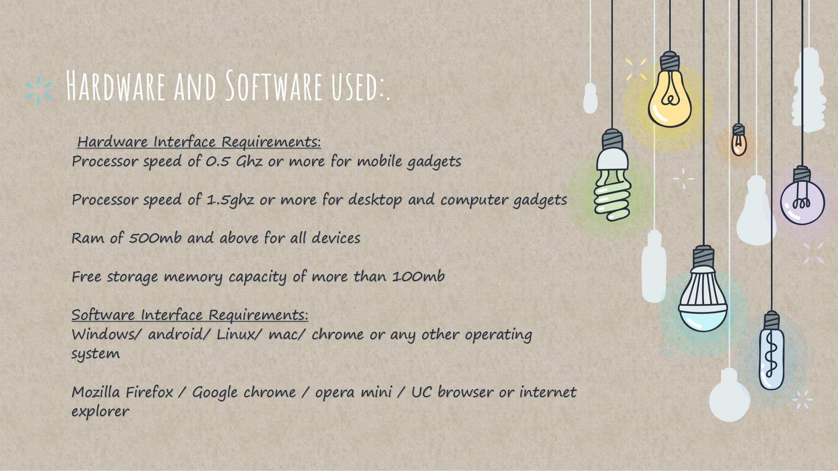
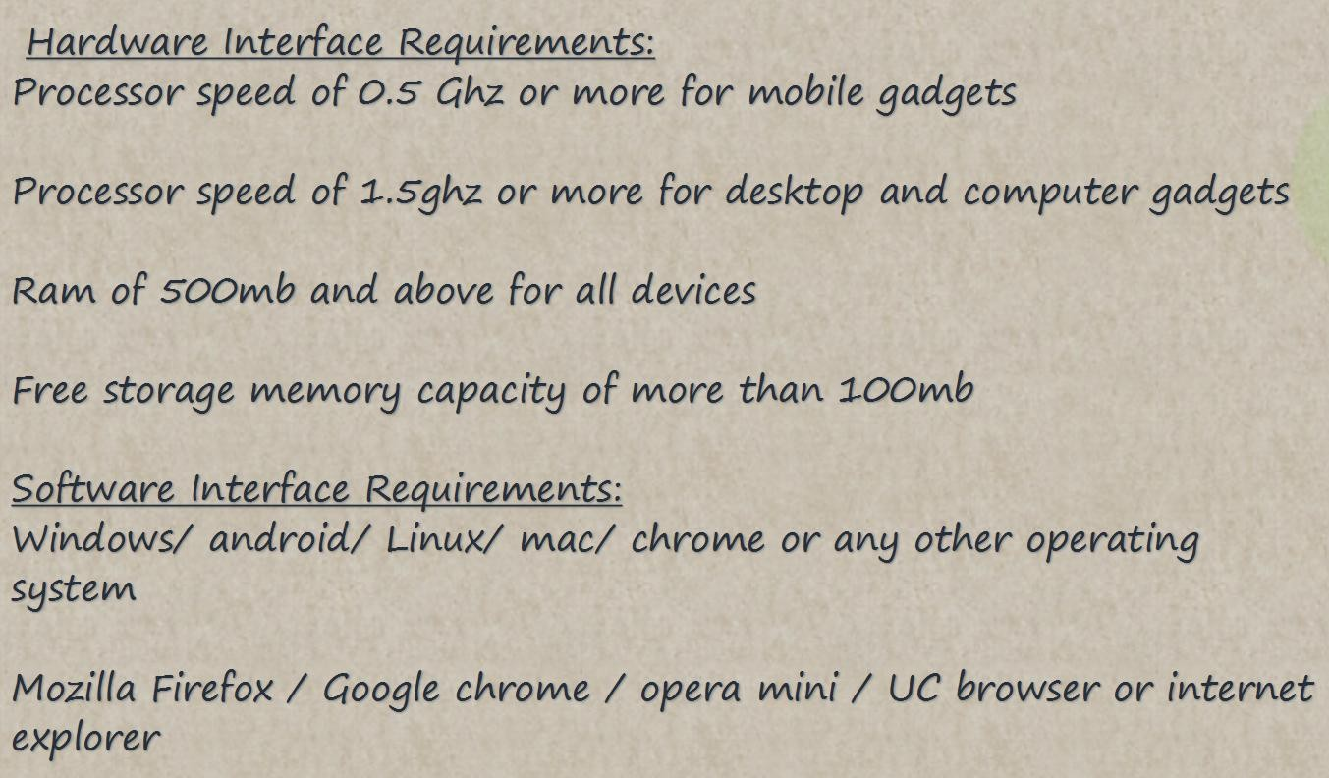
10

Slide 11

->MVC architecture has been used in this project.
->Connection of mysql database has been done successfully with the Java code.
->MultiThreading has also been used in this project.
->We also understood the importance of validation.
11

Slide 12
Thanks!

